Slide 1
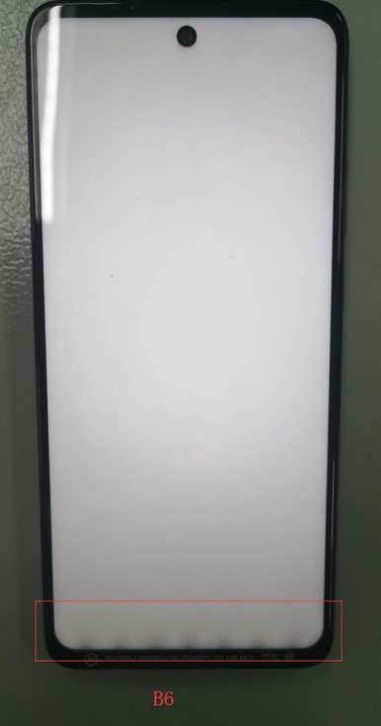
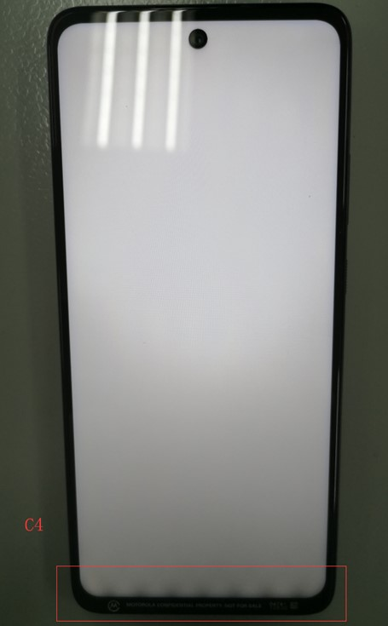
B6(0),C4(0)
Display edge backlight leakage.

Slide 2
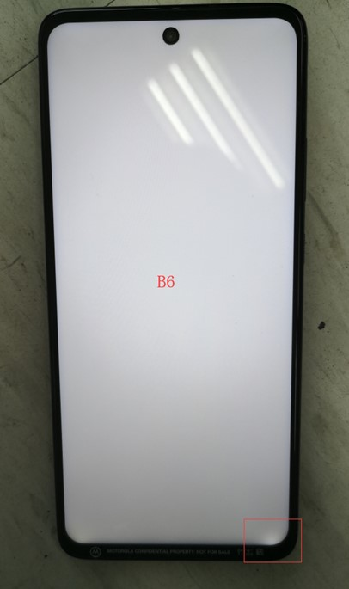
B6(4)
Display edge backlight leakage.

Slide 3
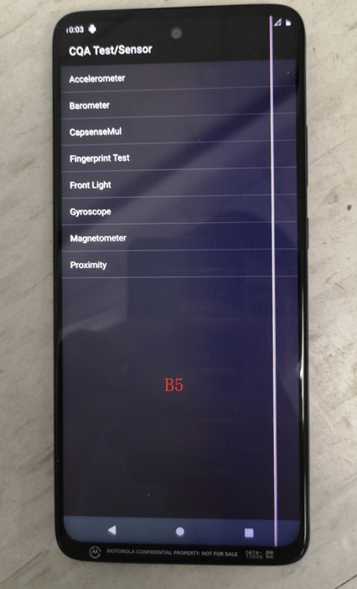
B5(5)
Display missing pixels.

Slide 4
ESD Report
Unit C1 - test without accessory Test Condition:25.4℃ 31.7% Tested by: HuangKai
DISCHARGE MODE | VOLTAGE LEVEL (kV) | Test Setup | Test Zone when abnormality was found | Pass/Fail | C O M M E N T S
AIR | +8 | Standby |  | Pass
 | -8 |  |  | Pass
AIR | +15 | Standby | Zone1 | Pass | +15KV air discharge at zone1(Aging 10),proximity sensor no function,recover after reboot.(7/15/2020,10:19)
 | -15 |  |  | Pass
Unit C2 - test with charger and Bluetooth Headset Test Condition:25.4℃ 31.7% Tested by: HuangKai
DISCHARGE MODE | VOLTAGE LEVEL (kV) | Test Setup | Test Zone when abnormality was found | Pass/Fail | C O M M E N T S
AIR | +8 | In a call |  | Pass
 | -8 |  |  | Pass
AIR | +15 | In a call |  | Pass
 | -15 |  |  | Pass
Remark:For C1 &C2 ESD test,GPS,BT,WLAN should be turned on.

Slide 5
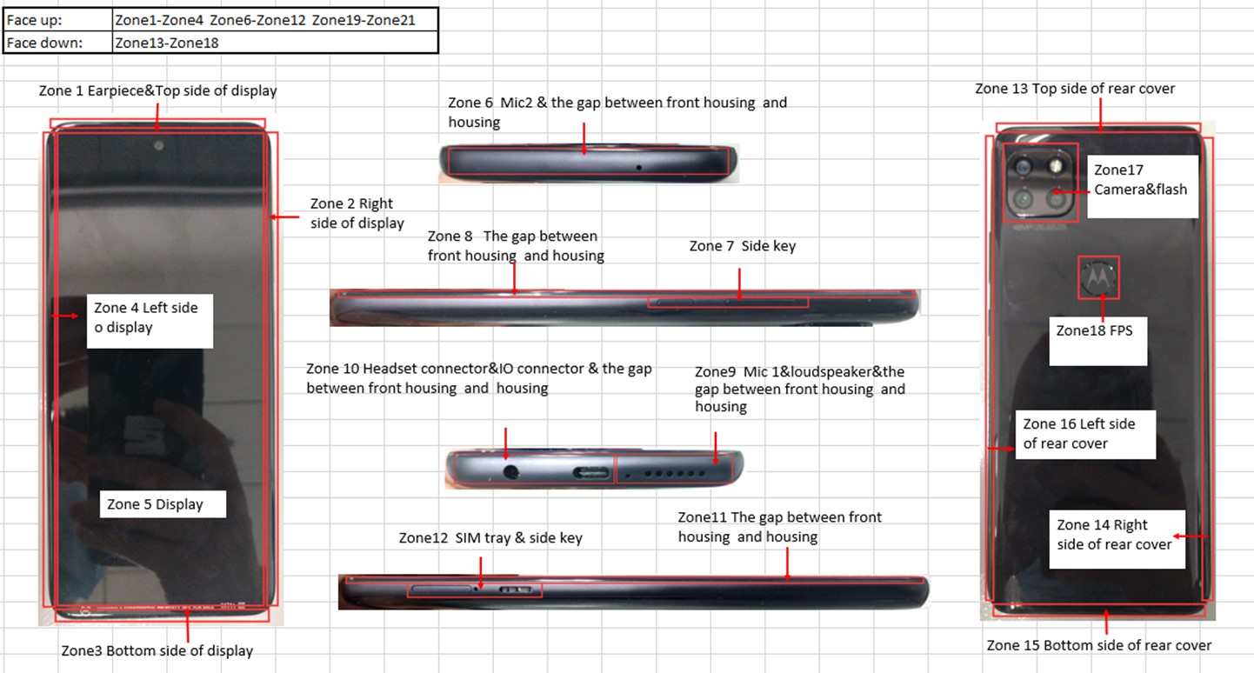
ESD Illustration

Slide 6
SPL Data
Inspector: HuangKai
Date: 7/18/2020
Unit: dB
SPL1 | Initial | final | Degradation | Result
A1 | 87 | 88.4 | 1.4 | PASS
A2 | 98.4 | 99.4 | 1 | PASS
A3 | 98.4 | 98.6 | 0.2 | PASS
A4 | 98.1 | 99.5 | 1.4 | PASS
A5 | 99 | 99.9 | 0.9 | PASS
A6 | 98.4 | 99.8 | 1.4 | PASS
B1 | 98.2 | 99.9 | 1.7 | PASS
B2 | 98.8 | 99.5 | 0.7 | PASS
B3 | 98.8 | 99.1 | 0.3 | PASS
B4 | 98.4 | 98.6 | 0.2 | PASS
B5 | 98.9 | / | / | NA
B6 | 87.4 | 88.6 | 1.2 | PASS
C1 | 99.1 | 99.9 | 0.8 | PASS
C2 | 87.8 | 87.4 | -0.4 | PASS
C3 | 98.4 | 99.8 | 1.4 | PASS
C4 | 98.8 | 99.5 | 0.7 | PASS

Slide 7
Template Version:Rev.O
Brometer test
Test Number:WH128516-2
Test by:huangkai
Date:07/16/2020
SN | Test Height/meter | Test Pressure/Hpa | Equipment Pressure/Hpa | Phone Pressure/Hpa | Thermal/C | Delta/Hpa | Fass/Fail
NK0T140084 | 0 | NTP | 998.5 | 999 |  | 0.5
NK0T140083 | 0 | NTP | 998.5 | 998.9 |  | 0.4
NK0T140056 | 0 | NTP | 998.5 | 999 |  | 0.5
NK0T140057 | 0 | NTP | 998.5 | 998.9 |  | 0.4
NK0T140043 | 0 | NTP | 998.5 | 998.9 |  | 0.4
NK0T140046 | 0 | NTP | 998.5 | 998.9 |  | 0.4
NK0T140047 | 0 | NTP | 998.5 | 998.9 |  | 0.4
NK0T140063 | 0 | NTP | 998.5 | 998.8 |  | 0.3
NK0T140059 | 0 | NTP | 998.5 | 998.9 |  | 0.4
NK0T140002 | 0 | NTP | 998.5 | 999 |  | 0.5
NK0T140069 | 0 | NTP | 998.5 | 998.9 |  | 0.4
NK0T140045 | 0 | NTP | 998.5 | 998.9 |  | 0.4

Slide 8
NK0T140084 | 500 | 954.6 | 954.9 | 955.4 |  | 0.5
NK0T140083 | 500 | 954.6 | 954.9 | 955.3 |  | 0.4
NK0T140056 | 500 | 954.6 | 954.9 | 955.4 |  | 0.5
NK0T140057 | 500 | 954.6 | 954.9 | 955.3 |  | 0.4
NK0T140043 | 500 | 954.6 | 954.9 | 955.3 |  | 0.4
NK0T140046 | 500 | 954.6 | 954.9 | 955.3 |  | 0.4
NK0T140047 | 500 | 954.6 | 954.9 | 955.3 |  | 0.4
NK0T140063 | 500 | 954.6 | 954.9 | 955.3 |  | 0.4
NK0T140059 | 500 | 954.6 | 954.9 | 955.4 |  | 0.5
NK0T140002 | 500 | 954.6 | 954.9 | 955.4 |  | 0.5
NK0T140069 | 500 | 954.6 | 954.9 | 955.3 |  | 0.4
NK0T140045 | 500 | 954.6 | 954.9 | 955.3 |  | 0.4
NK0T140084 | 1000 | 899.5 | 897.6 | 897.9 |  | 0.3
NK0T140083 | 1000 | 899.5 | 897.6 | 897.8 |  | 0.2
NK0T140056 | 1000 | 899.5 | 897.6 | 897.9 |  | 0.3
NK0T140057 | 1000 | 899.5 | 897.6 | 897.8 |  | 0.2
NK0T140043 | 1000 | 899.5 | 897.6 | 897.8 |  | 0.2
NK0T140046 | 1000 | 899.5 | 897.6 | 897.8 |  | 0.2
NK0T140047 | 1000 | 899.5 | 897.6 | 897.8 |  | 0.2
NK0T140063 | 1000 | 899.5 | 897.6 | 897.8 |  | 0.2
NK0T140059 | 1000 | 899.5 | 897.6 | 897.8 |  | 0.2
NK0T140002 | 1000 | 899.5 | 897.6 | 897.9 |  | 0.3
NK0T140069 | 1000 | 899.5 | 897.6 | 897.8 |  | 0.2
NK0T140045 | 1000 | 899.5 | 897.6 | 897.8 |  | 0.2

Slide 9
NK0T140084 | 1500 | 845.5 | 844.6 | 844.7 |  | 0.1
NK0T140083 | 1500 | 845.5 | 844.6 | 844.7 |  | 0.1
NK0T140056 | 1500 | 845.5 | 844.6 | 844.8 |  | 0.2
NK0T140057 | 1500 | 845.5 | 844.6 | 844.7 |  | 0.1
NK0T140043 | 1500 | 845.5 | 844.6 | 844.6 |  | 0
NK0T140046 | 1500 | 845.5 | 844.6 | 844.7 |  | 0.1
NK0T140047 | 1500 | 845.5 | 844.6 | 844.6 |  | 0
NK0T140063 | 1500 | 845.5 | 844.6 | 844.6 |  | 0
NK0T140059 | 1500 | 845.5 | 844.6 | 844.7 |  | 0.1
NK0T140002 | 1500 | 845.5 | 844.6 | 844.7 |  | 0.1
NK0T140069 | 1500 | 845.5 | 844.6 | 844.7 |  | 0.1
NK0T140045 | 1500 | 845.5 | 844.6 | 844.6 |  | 0
NK0T140084 | 2000 | 794.8 | 793.3 | 793.7 |  | 0.4
NK0T140083 | 2000 | 794.8 | 793.3 | 793.6 |  | 0.3
NK0T140056 | 2000 | 794.8 | 793.3 | 793.7 |  | 0.4
NK0T140057 | 2000 | 794.8 | 793.3 | 793.6 |  | 0.3
NK0T140043 | 2000 | 794.8 | 793.3 | 793.6 |  | 0.3
NK0T140046 | 2000 | 794.8 | 793.3 | 793.6 |  | 0.3
NK0T140047 | 2000 | 794.8 | 793.3 | 793.6 |  | 0.3
NK0T140063 | 2000 | 794.8 | 793.3 | 793.6 |  | 0.3
NK0T140059 | 2000 | 794.8 | 793.3 | 793.7 |  | 0.4
NK0T140002 | 2000 | 794.8 | 793.3 | 793.6 |  | 0.3
NK0T140069 | 2000 | 794.8 | 793.3 | 793.6 |  | 0.3
NK0T140045 | 2000 | 794.8 | 793.3 | 793.6 |  | 0.3

Slide 10
NK0T140084 | 2500 | 746.7 | 745.6 | 745.7 |  | 0.1
NK0T140083 | 2500 | 746.7 | 745.6 | 745.6 |  | 0
NK0T140056 | 2500 | 746.7 | 745.6 | 745.7 |  | 0.1
NK0T140057 | 2500 | 746.7 | 745.6 | 745.7 |  | 0.1
NK0T140043 | 2500 | 746.7 | 745.6 | 745.6 |  | 0
NK0T140046 | 2500 | 746.7 | 745.6 | 745.6 |  | 0
NK0T140047 | 2500 | 746.7 | 745.6 | 745.6 |  | 0
NK0T140063 | 2500 | 746.7 | 745.6 | 745.6 |  | 0
NK0T140059 | 2500 | 746.7 | 745.6 | 745.6 |  | 0
NK0T140002 | 2500 | 746.7 | 745.6 | 745.7 |  | 0.1
NK0T140069 | 2500 | 746.7 | 745.6 | 745.6 |  | 0
NK0T140045 | 2500 | 746.7 | 745.6 | 745.6 |  | 0

